Slide 1
GET DOC.|AN INNOVATIVE STEP
TASK: 01
Presented By: Soham Patil
(AI Intern, Hackveda.)

Slide 2
Table of Content
Hook Story
INTRO
OBJECTIVE
TECHNO
-LOGIES
DEMO
QNA

Slide 3
HOOK-STORY
In a bustling metropolis amidst the hum of daily life, Sarah found herself in need of a specialist for her mother's critical condition. She spent hours scouring through directories, making endless calls, only to face dead ends and uncertainty. Frustration mounted as time passed until she discovered a beacon of hope—Doctor Search Website (GET DOC).
With a few clicks, Sarah navigated through a user-friendly interface that offered detailed profiles of doctors, complete with specialties, patient reviews, and availability. It was a revelation—a digital sanctuary where healthcare decisions were empowered by information and ease.
As she booked an appointment with a top-rated cardiologist, Sarah marveled at the simplicity and efficiency of the platform. No longer bound by the limitations of traditional healthcare access, she found solace in knowing that her mother's care was in capable hands.

Slide 4
INTRODUCTION
In an era where technology touches every aspect of our lives, the healthcare sector is no exception. Traditional methods of finding a doctor often involve time-consuming searches, word-of-mouth recommendations, and lengthy wait times.
Our Doctor Search Website aims to streamline this process, offering a comprehensive database of verified doctors, detailed profiles, and an intuitive booking system designed to enhance the patient experience.

Slide 5
OBJECTIVE
Develop a user-friendly website interface
Patients can search for doctors based on their specialties, location, and availability.
Providing an intuitive and responsive web interface accessible from any device.
Streamline appointment scheduling through an efficient online booking system, reducing administrative burdens for healthcare providers and patients.
Promote health equity by addressing gaps in access to medical expertise, especially in underserved communities.

Slide 6





TECHNOLOGIES
XAMPP
PHP
SQL
HTML5
CSS3

Slide 7
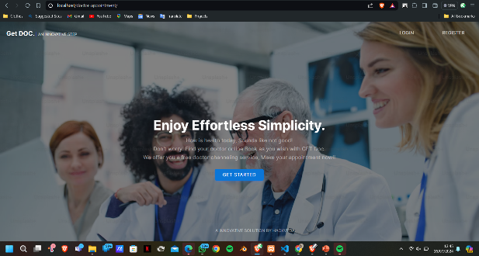
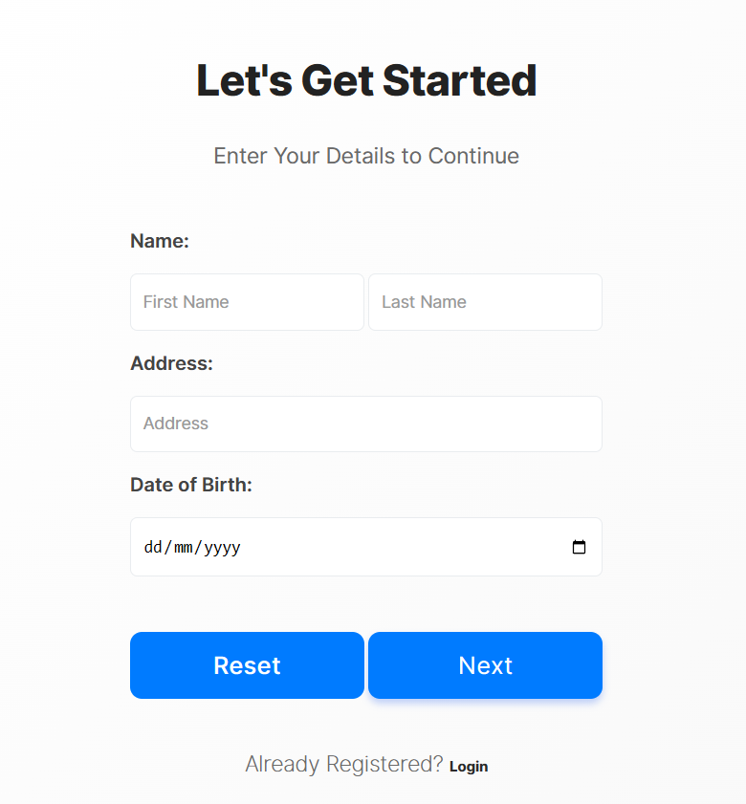
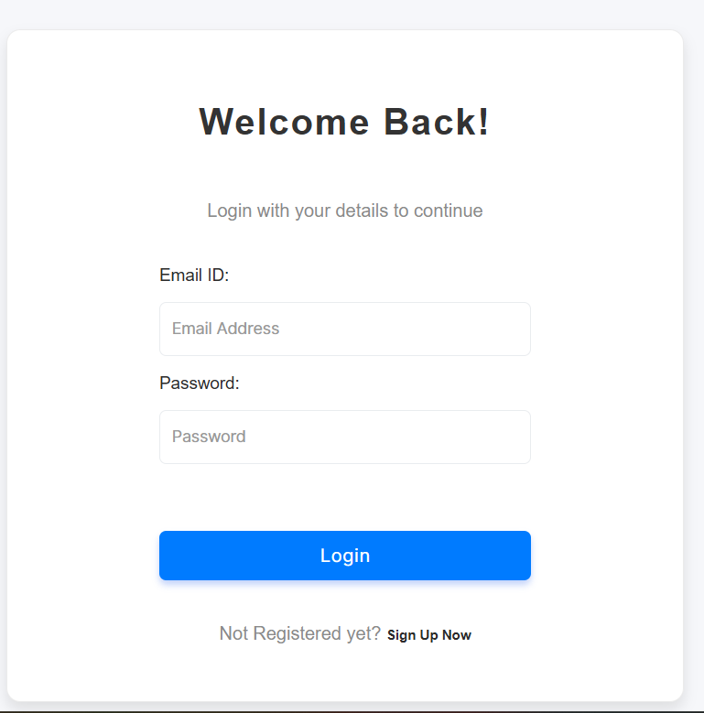
DEMONSTRATION
PREVIEW
SIGNIN PAGE
LOGIN PAGE

Slide 8
QNA
For Any Quries And Doubt you can reach me at sohampatil0715@gmail.com
Thank You!

